Slide 1
Developing an Information Management Code Repository
Kristin Vanderbilt
Colin Smith
Environmental Data Initiative

Slide 2
What is the IM code repository?
A place to go for information management code solutions
A community space, where IM community participants contribute code and discover code to re-use
Our goal today is to create a blueprint for how the IM code repository will operate

Slide 3

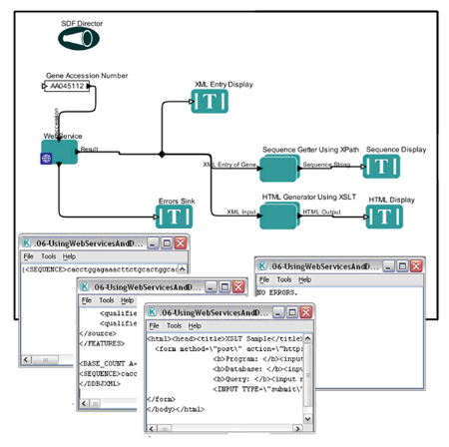

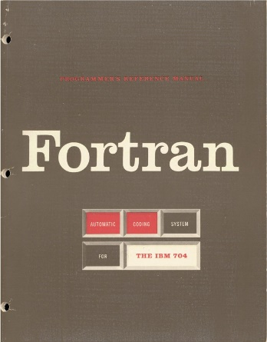


Our vision
Contributors/users of this repository
Range of tasks to which code should apply
Acceptable programming languages
http://kepler-project.org

Slide 4
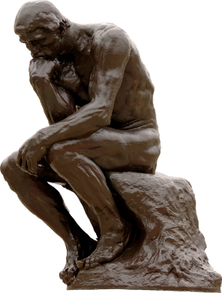
Considerations:
Repository structure
Governance
Discoverability
Re-use

Slide 5
How should we structure the IM Code Repository?
Decentralized approach – the repository is essentially a catalog, pointing to whatever repository the code developer prefers
Centralized approach – all code is in github
Hybrid approach – a catalog plus the centralized repository
Issues:
Searching within and across code repositories
Repository persistence
DOI assignment
Governance

Slide 6
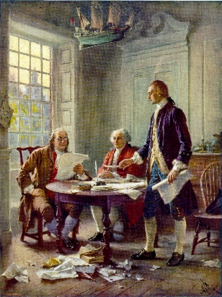
How should the code repository be governed?
A committee:
Specialists in different programming languages.
Responsible for ensuring that code passes quality tests and evaluating metadata for quality and completeness.
Distributed workload.
Issues:
Number of members
Term of service and rotation
Credit for service

Slide 7

What are the minimum requirements that a script should meet?
Generalized, not project specific
Well documented at the code package level and within the source code
CodeMeta minimal metadata schema for science software and code
Documentation of how code is installed and used
Controlled vocabulary terms
Code is thoroughly commented and adheres to a language-specific style guide
Pass conceptual tests and tests of the code itself
Example data sets and expected output (use cases)
Provides meaningful error messages

Slide 8


Other considerations
Incentives to contribute to repository
Maintenance/updates of code
User Support
Licensing

Slide 9

Join us to finish the IM Repository blueprint!
Volunteers sought to co-author and review the ‘blueprint’ once we have assembled it.

